Slide 1
Introduction to
deep learning
Sungjoon Choi
(sungjoon.choi@cpslab.snu.ac.kr)

Slide 2

Deep learning
Wikipedia says:
“Deep learning is a branch of machine learning based on a set of algorithms that attempt to model high-level abstractions in data by using multiple processing layers, with complex structures or otherwise, composed of multiple non-linear transformations.”
High-level
abstraction
Machine
Learning
Network

Slide 3
Deep learning
Artificial Intelligence
Machine Learning
Deep learning
MLP
CNN
RNN

Slide 4
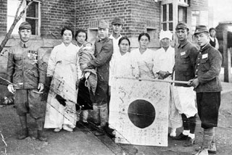
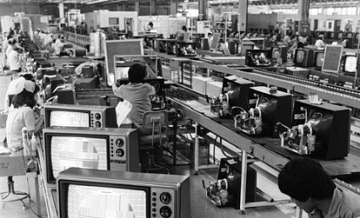
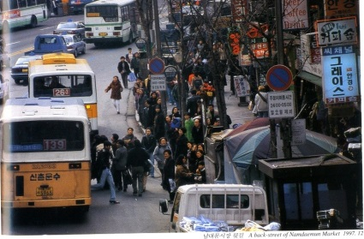
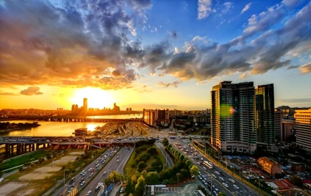
Is it brand new?
Neural Nets
McCulloch & Pitt 1943
Perceptron
Rosenblatt 1958
RNN
Grossberg 1973
CNN
Fukushima 1979
RBM
Hinton 1999
DBN
Hinton 2006
D-AE
Vincent 2008
AlexNet
Alex 2012
GoogLeNet
Szegedy 2015

Slide 5
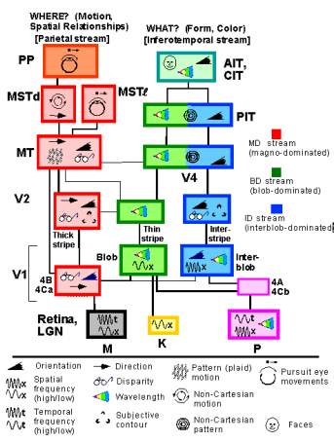
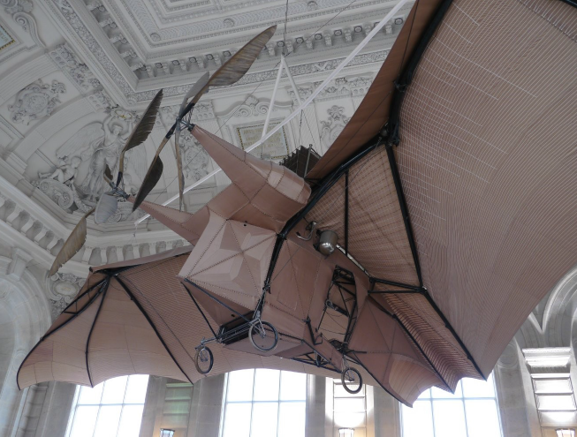
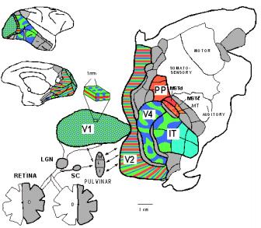

Inspired by nature?
L'Avion III de Clement Ader, 1897
Sure there is some resemblance!
But, do not go TOO FAR.
Slide credit: Yann LeCun

Slide 6
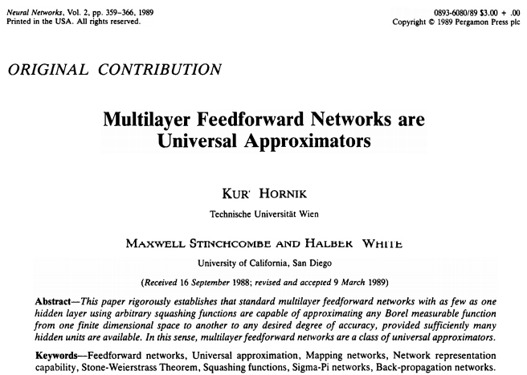
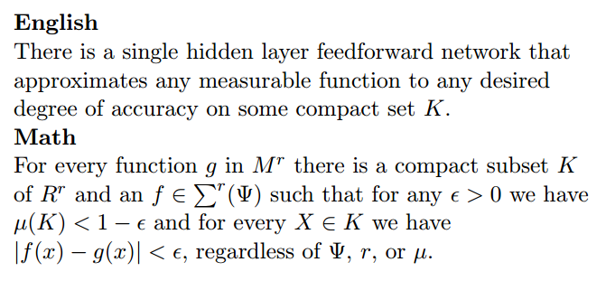
Theory
Cited > 12,000

Slide 7
Deep learning tools?
MatConvNet
Theano
TensorFlow
Torch
Caffe

Slide 8
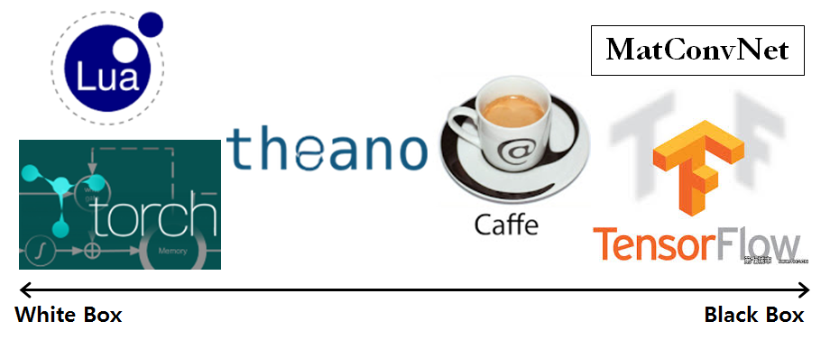
White to black

Slide 9
Course Contents
Sungjoon Choi
(sungjoon.choi@cpslab.snu.ac.kr)

Slide 10
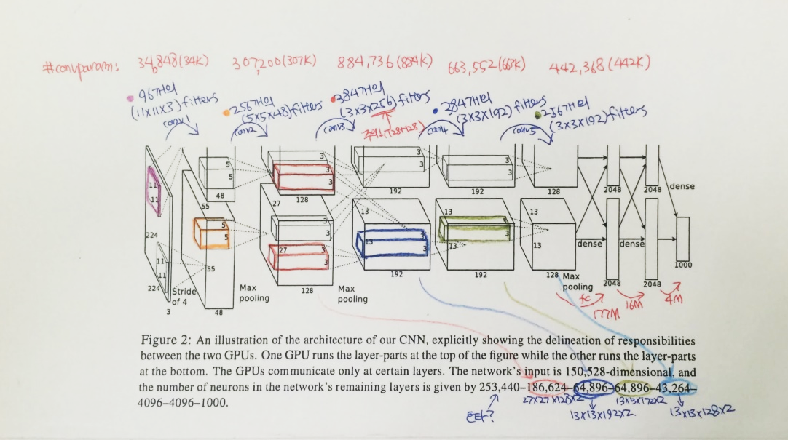
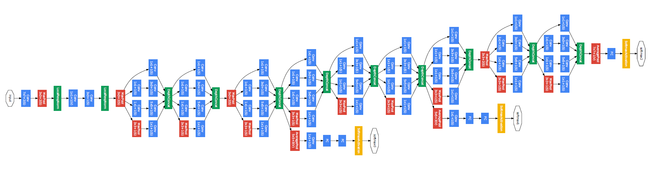
Convolutional neural network
AlexNet
GoogleLeNet

Slide 11
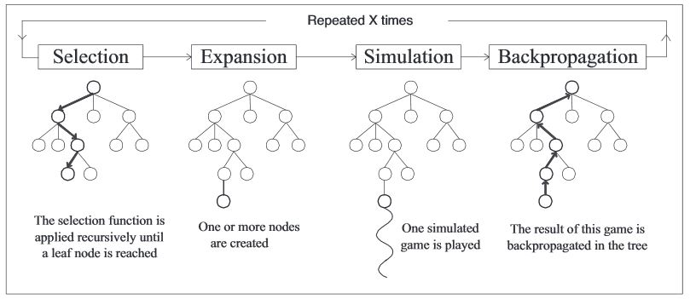
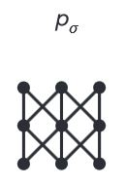
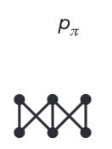
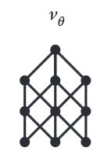
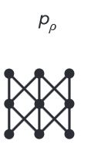
Algorithms behind AlphaGo
Rollout net
Value net
RL net
SL Policy Network

Slide 12

Regularization
Main purpose is to avoid “OverFitting”

Slide 13


Optimization Methods

Slide 14
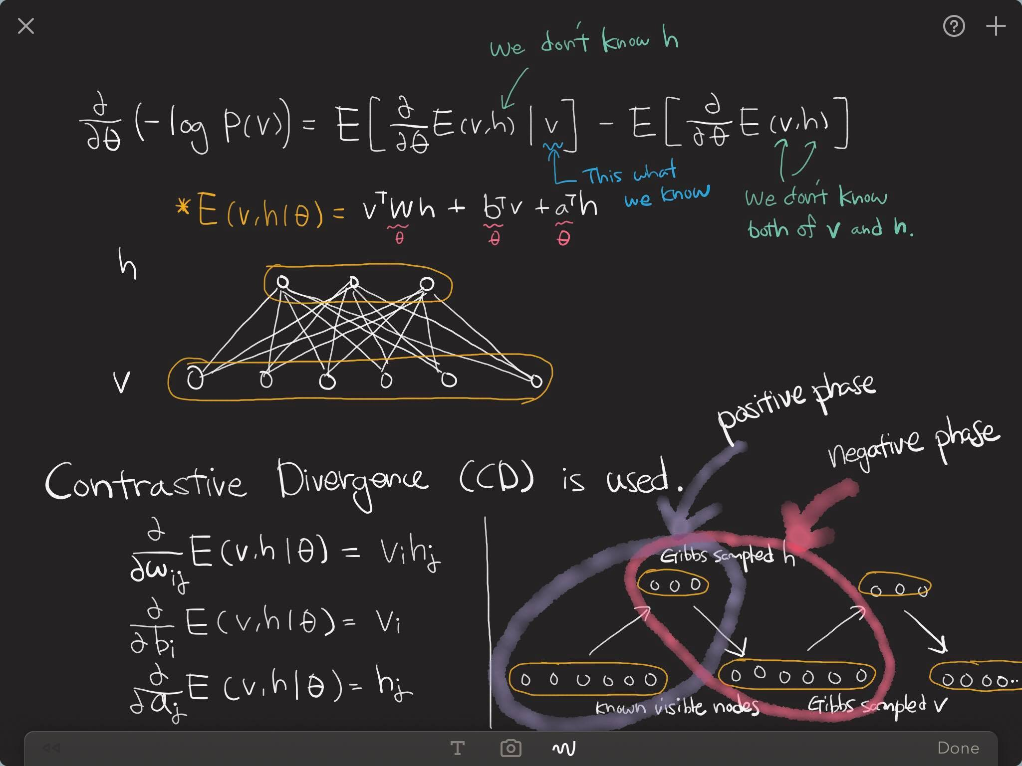
Restricted Boltzmann machine

Slide 15
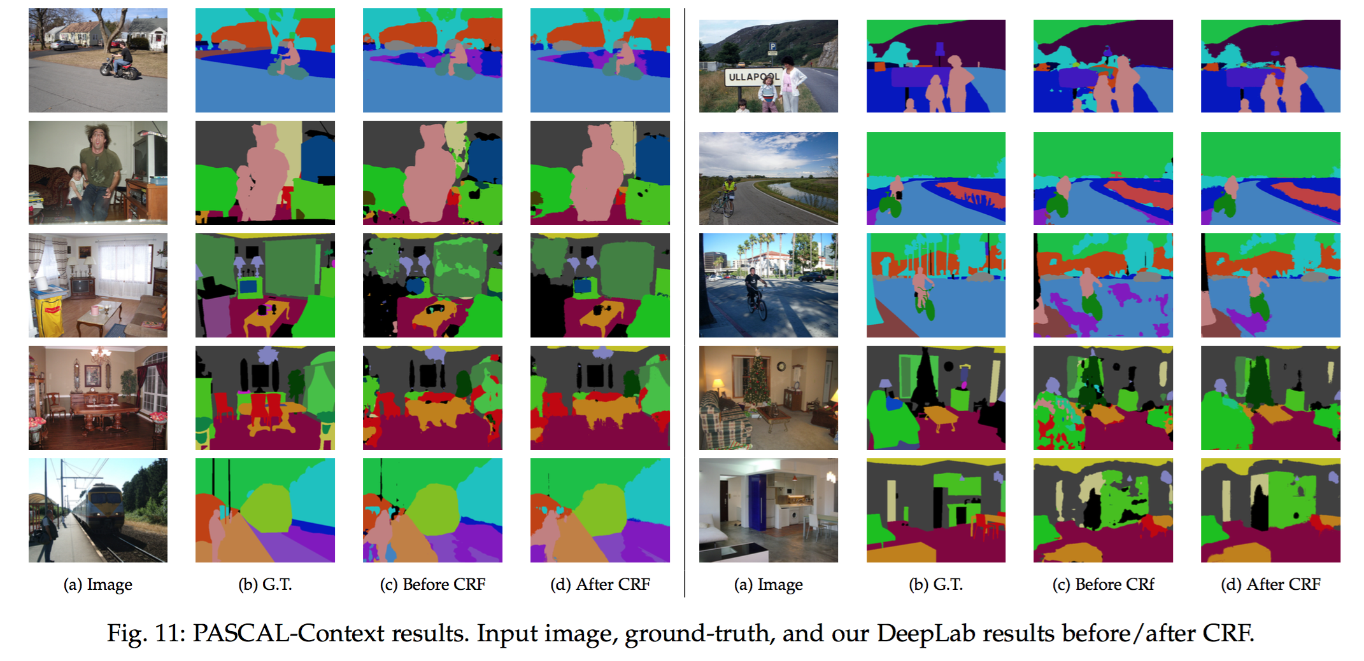
Semantic Segmentation

Slide 16
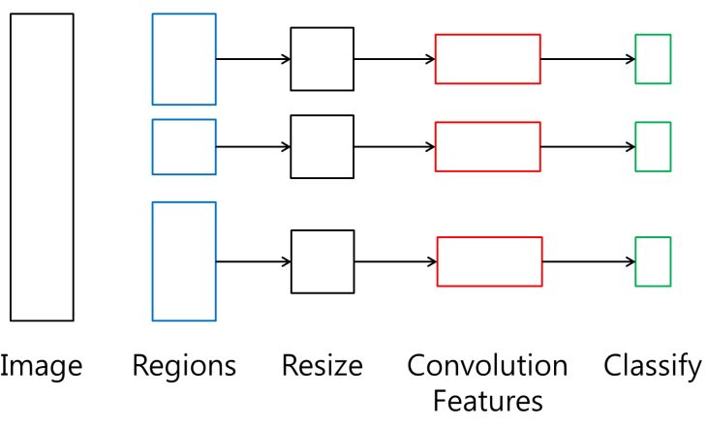
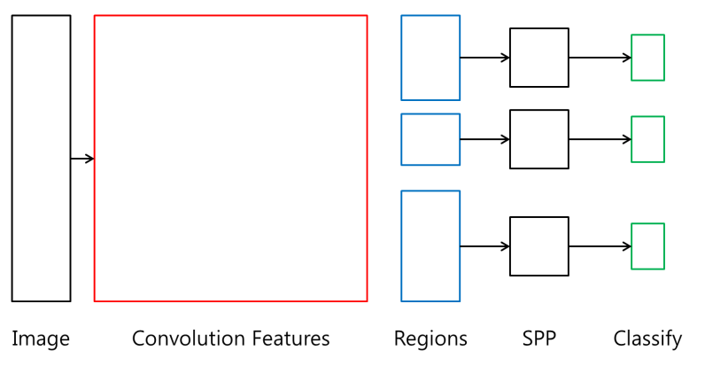
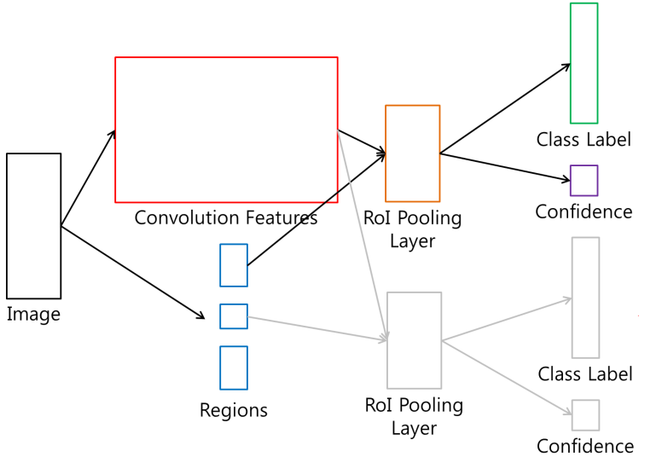
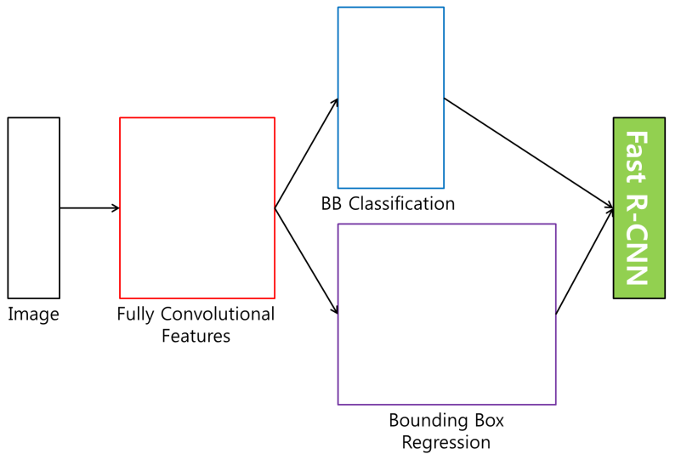
Detection Methods
R-CNN
SPP net
Fast R-CNN
Faster R-CNN

Slide 17

RNN - LSTM
Output
Forget Gate
(Cell) state
Next (Cell) State
Input Gate
Output Gate
Hidden State
Next Hidden State
Input
Output = Hidden state
17
http://colah.github.io/posts/2015-08-Understanding-LSTMs/

Slide 18
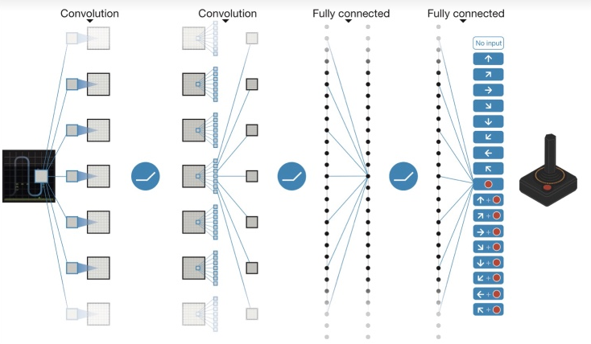
Deep Reinforcement Learning

Slide 19
Word Embedding

Slide 20
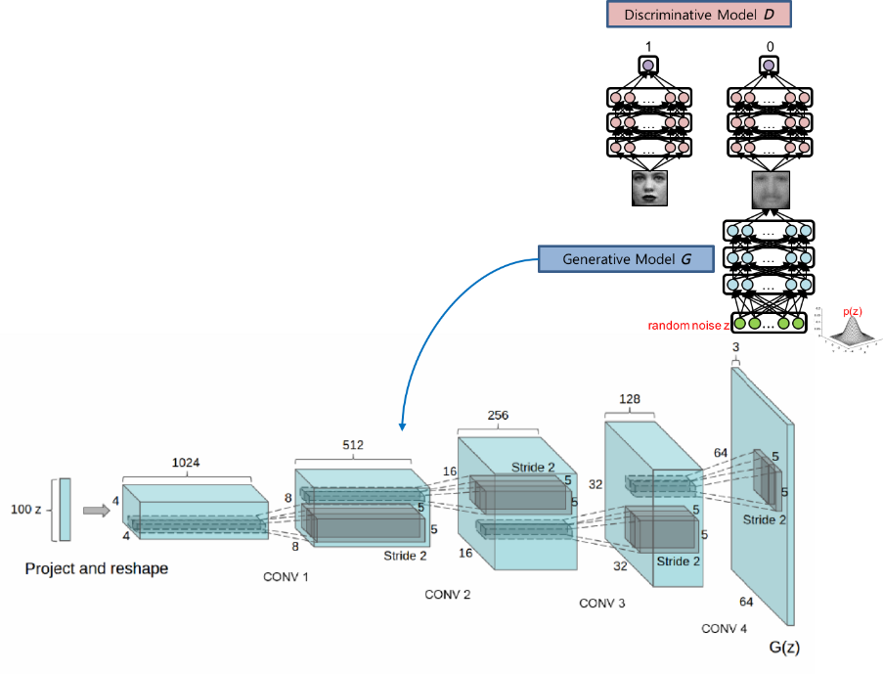
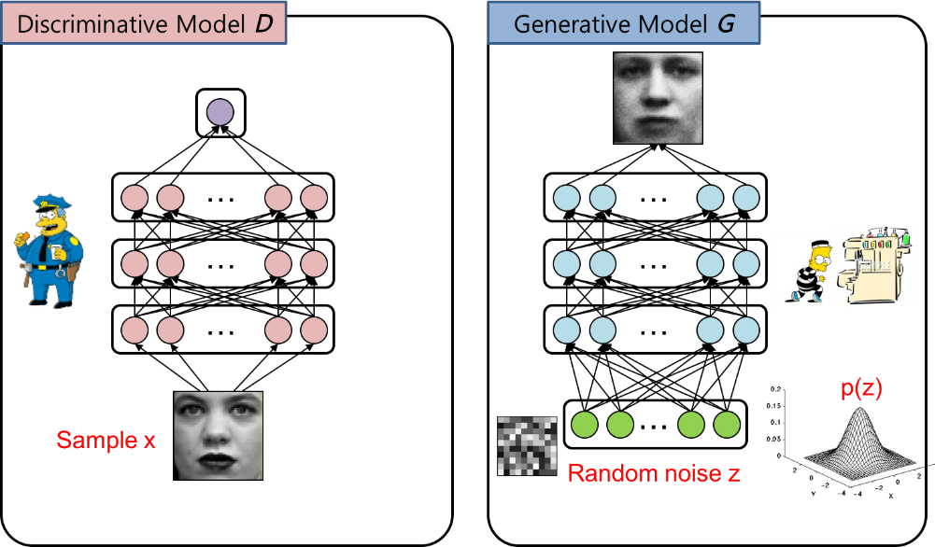
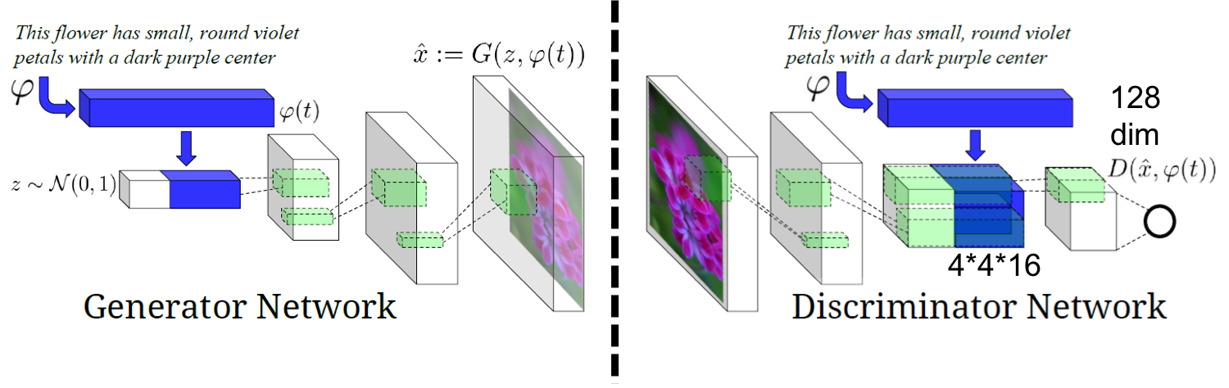
Generative Adversarial Networks

Slide 21
+ Alpha

Slide 22
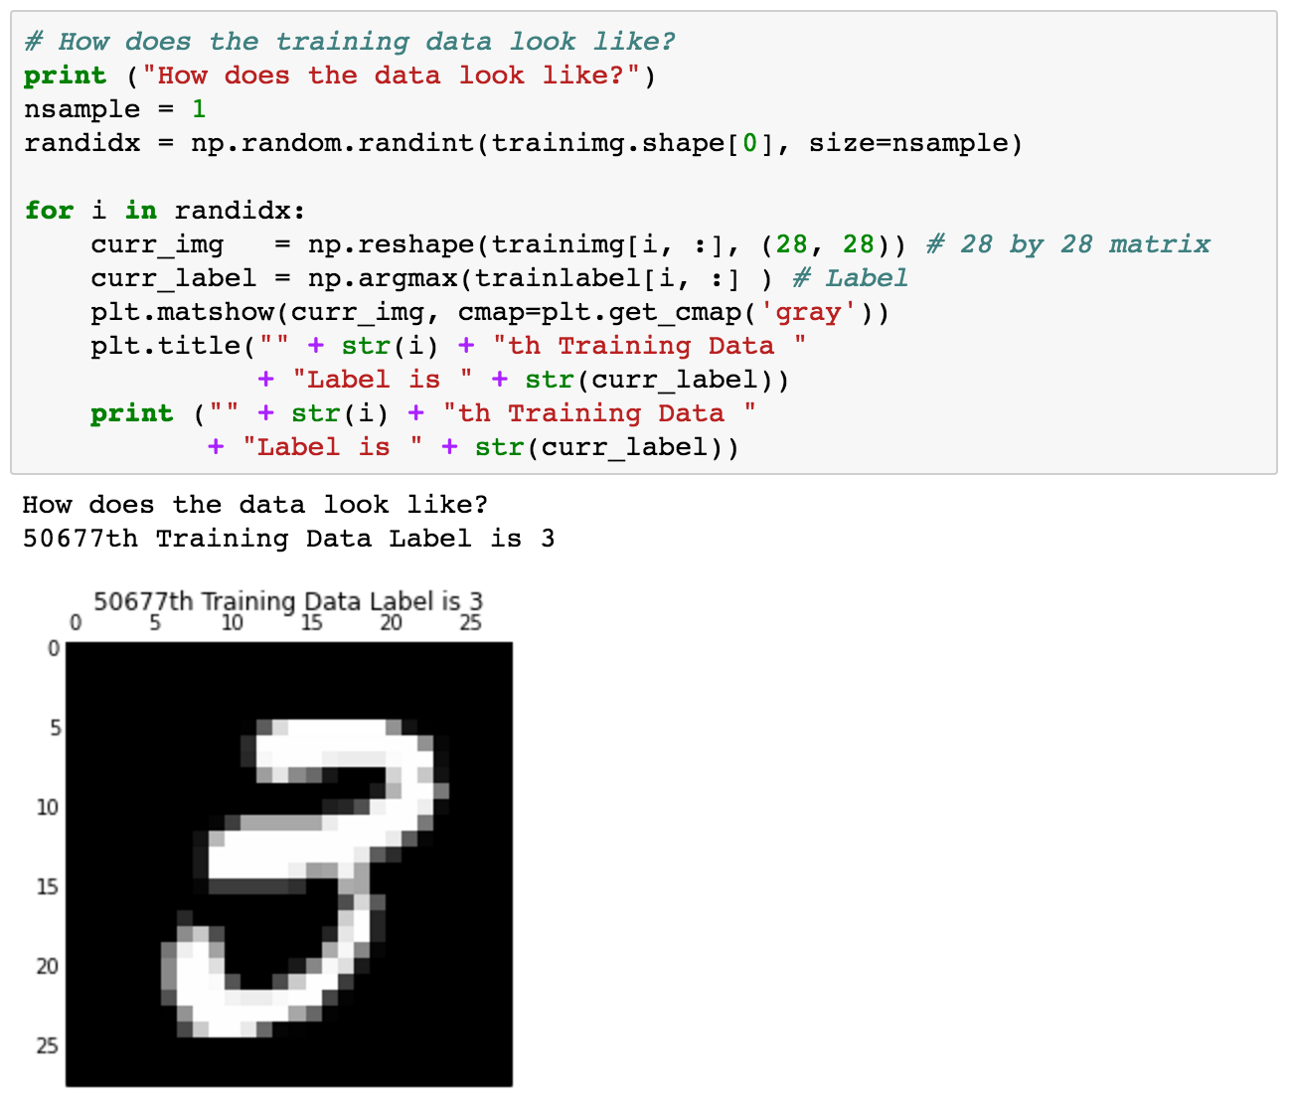
Using MNIST

Slide 23
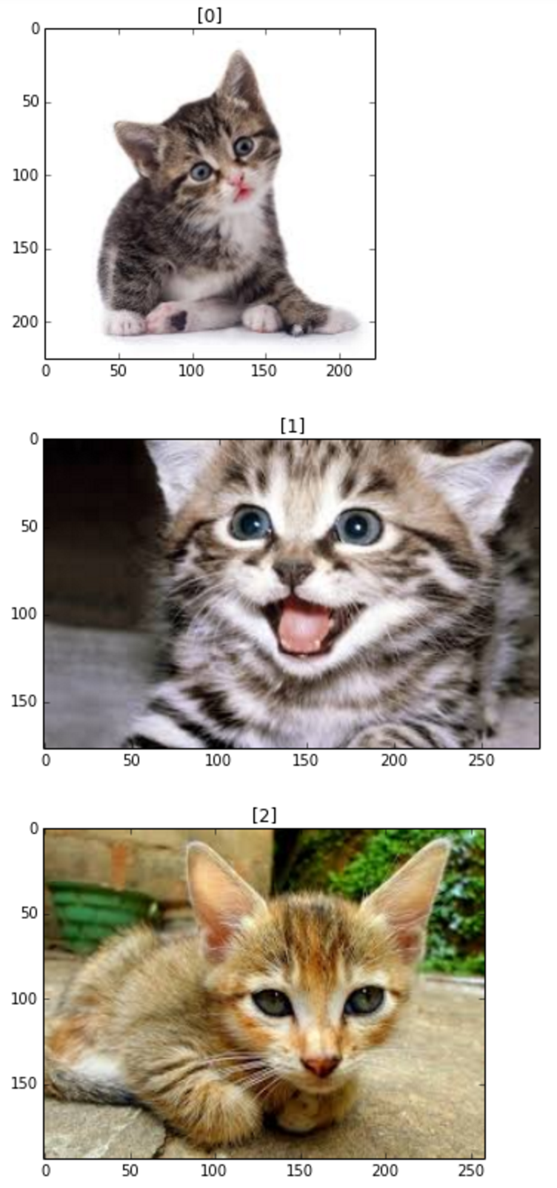
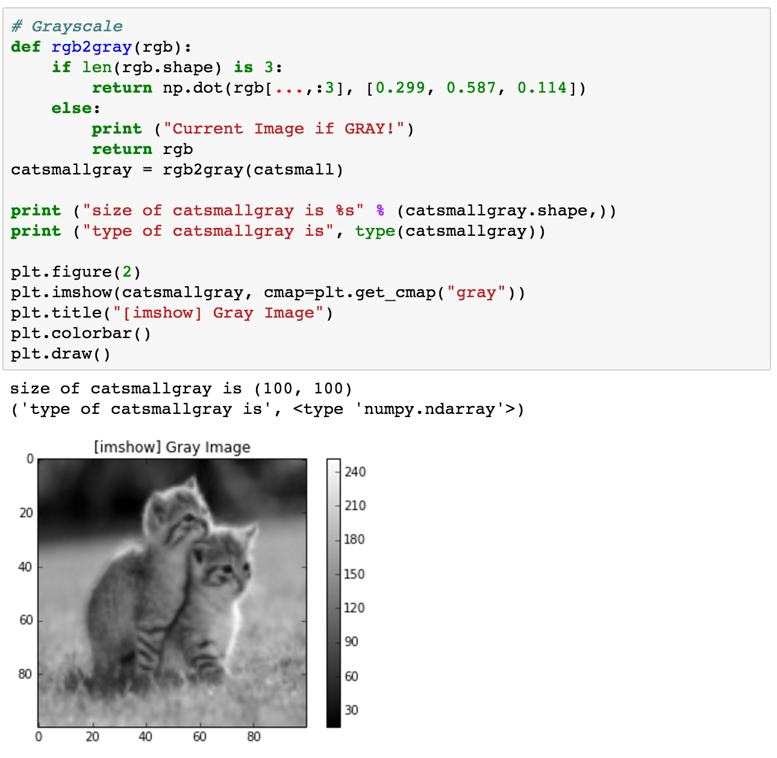
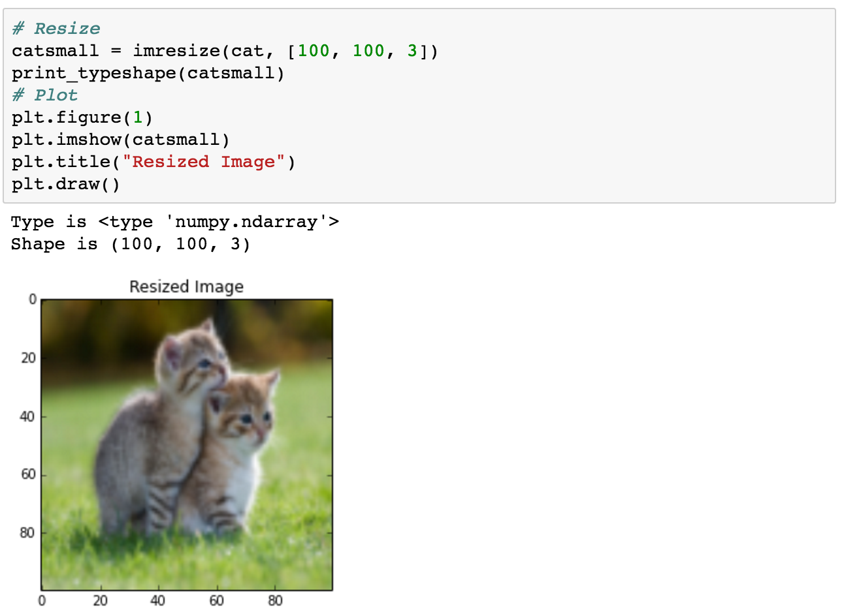
Basic Image Handling

Slide 24
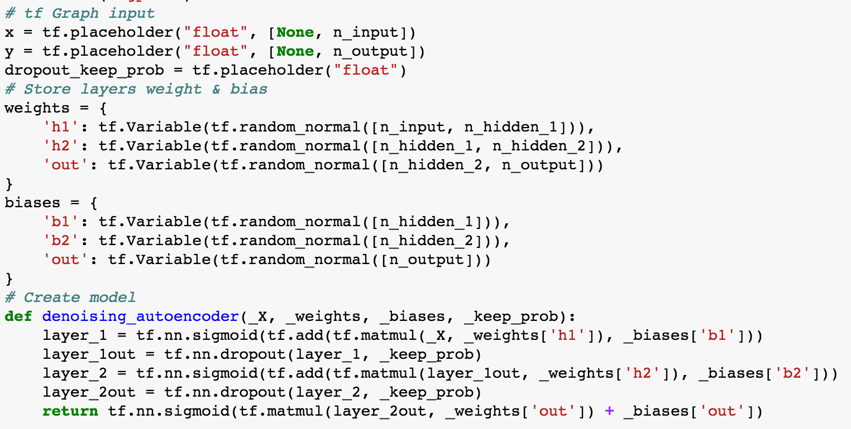
Denoising Auto-Encoder

Slide 25
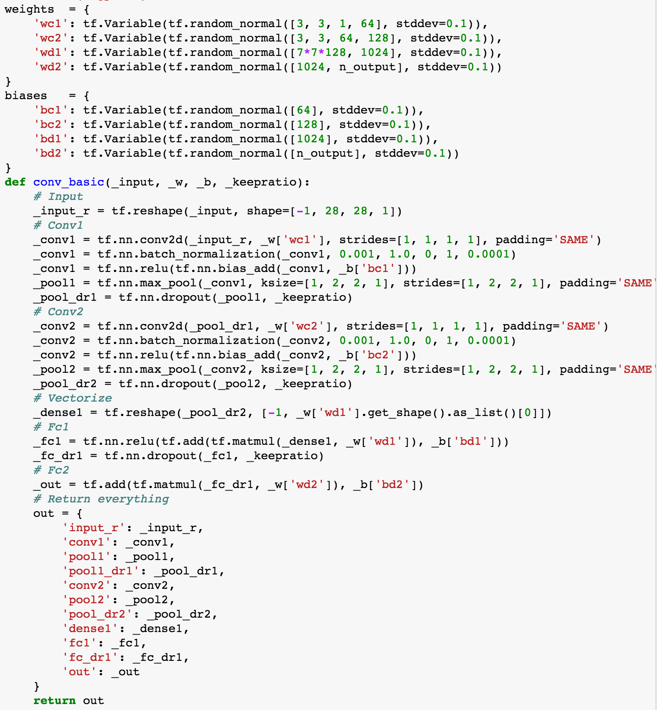
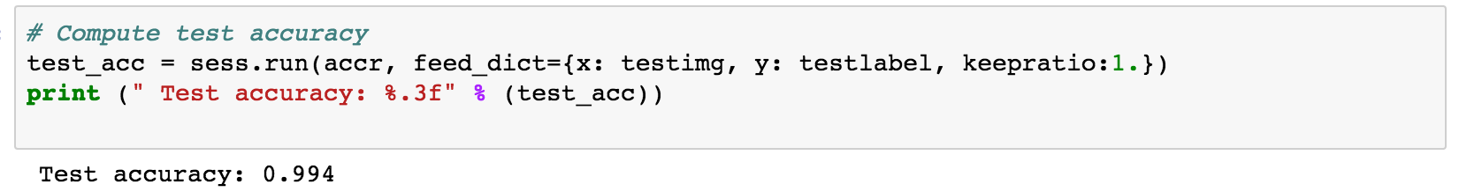
Convolutional Neural Network

Slide 26
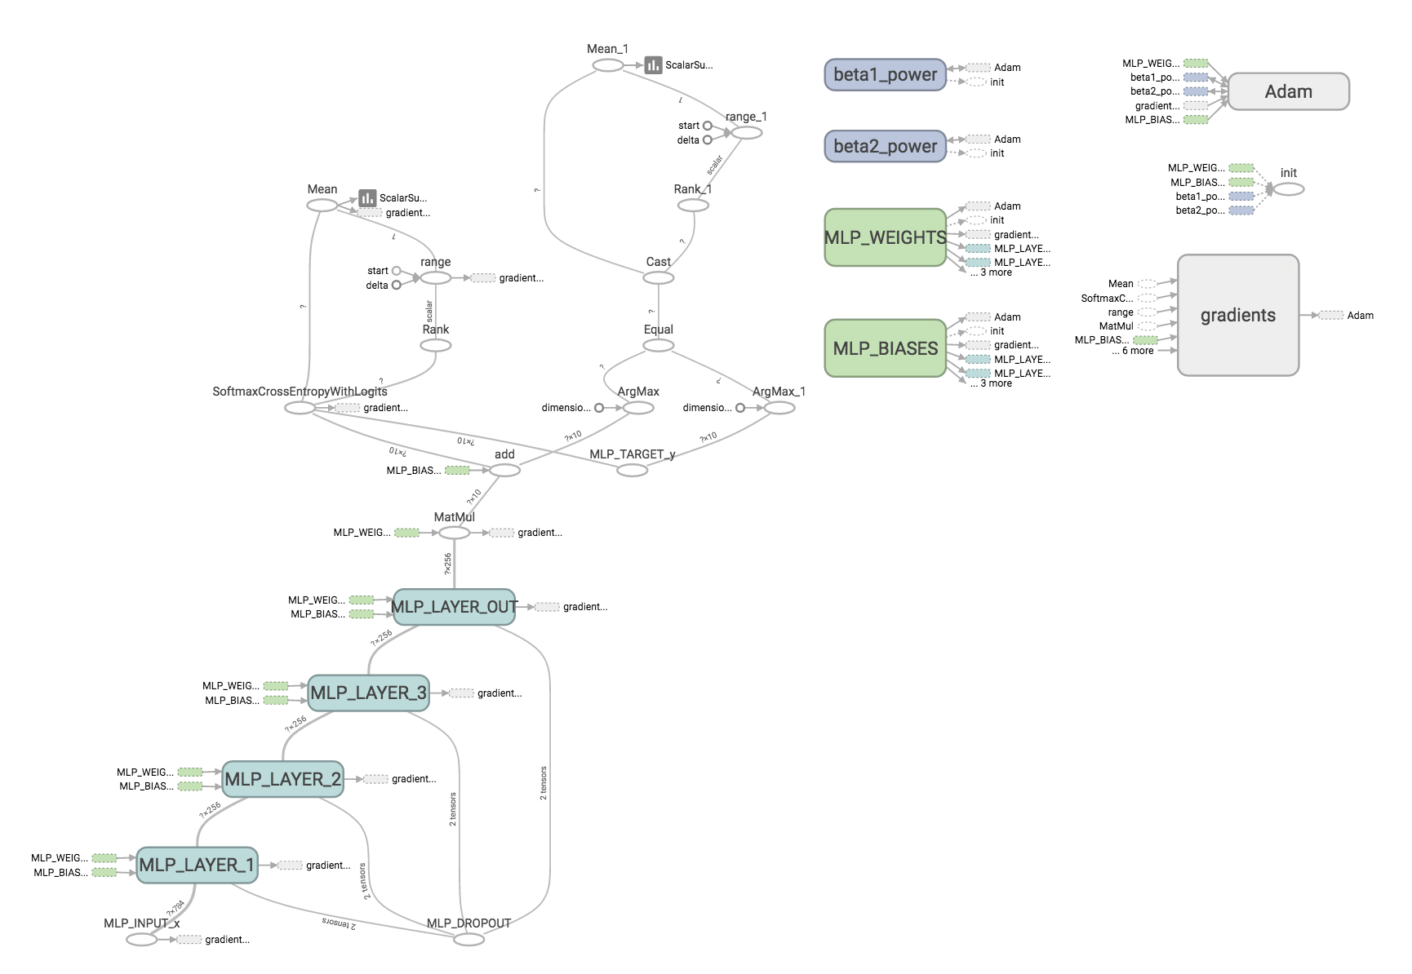
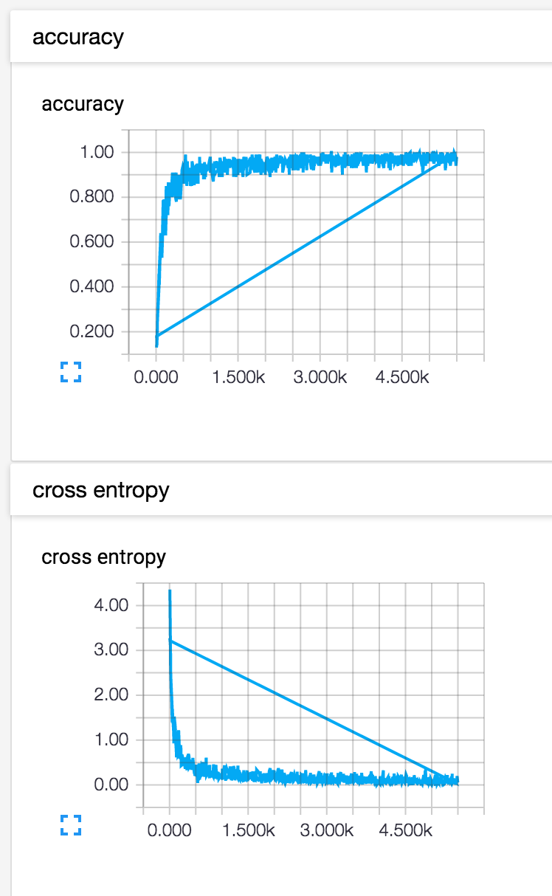
Tensor Board

Slide 27
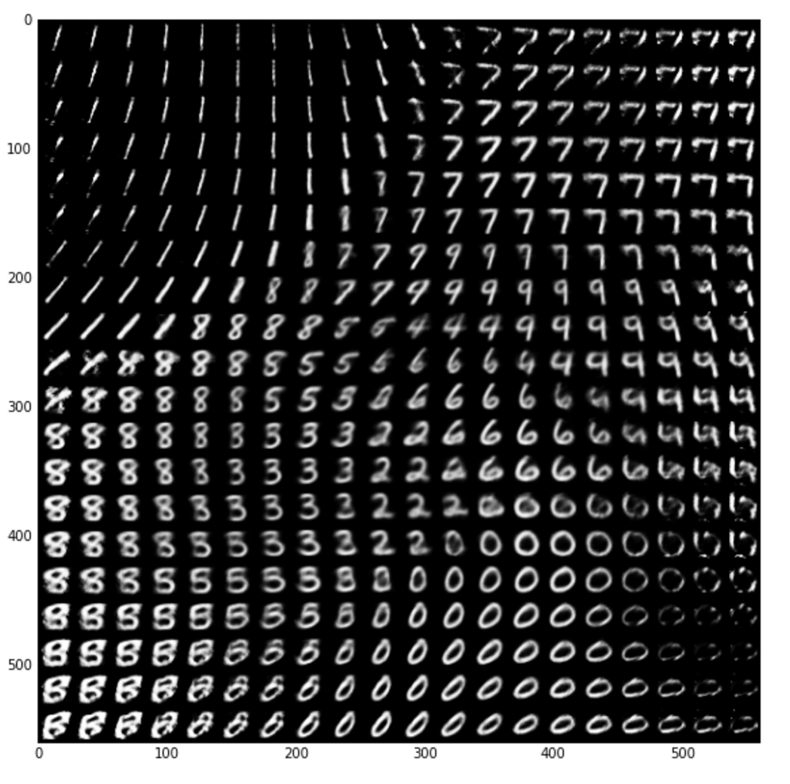
Variational Autoencoder (VAE)

Slide 28
Introduction to CNNs
Sungjoon Choi
(sungjoon.choi@cpslab.snu.ac.kr)

Slide 29
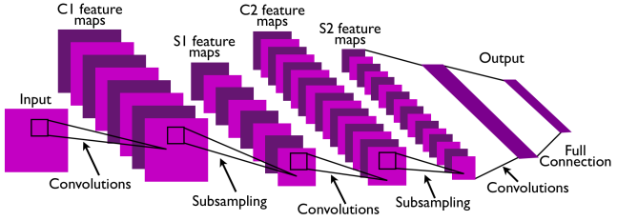
CNN
Convolutional Neural Network
This is pretty much everything about the convolutional neural network.
Convolution + Subsampling + Full Connection

Slide 30

CNN
CNNs are basically layers of convolutions followed by subsampling and fully connected layers.
Intuitively speaking, convolutions and subsampling layers works as feature extraction layers while a fully connected layer classifies which category current input belongs to using extracted features.

Slide 31

Why so powerful?
Local Invariance
Loosely speaking, as the convolution filters are ‘sliding’ over the input image, the exact location of the object we want to find does not matter much.
Compositionality
There is a hierarchy in CNNs. It is GOOD!
https://starwarsanon.wordpress.com/tag/darth-sidious-vs-yoda/

Slide 32

Convolution
http://deeplearning.stanford.edu/wiki/index.php/Feature_extraction_using_convolution

Slide 33
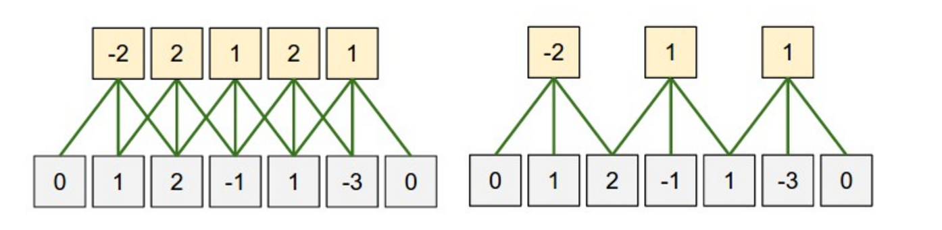
Zero-padding
What is the size of the input?
$n_{in}=5$
What is the size of the output?
$n_{out}=5$
What is the size of the filter?
$n_{filter}=3$
What is the size of the zero-padding?
$n_{padding}=1$
$n_{out}=\left(n_{in}+2∗n_{padding}−n_{filter}\right)+1$
$5=\left(5+2∗1−3\right)+1$

Slide 34

Stride

Slide 35
Stride
(Left) Stride size: 1
(Right) Stride size: 2
If stride size equals the filter size, there will be no overlapping.

Slide 36
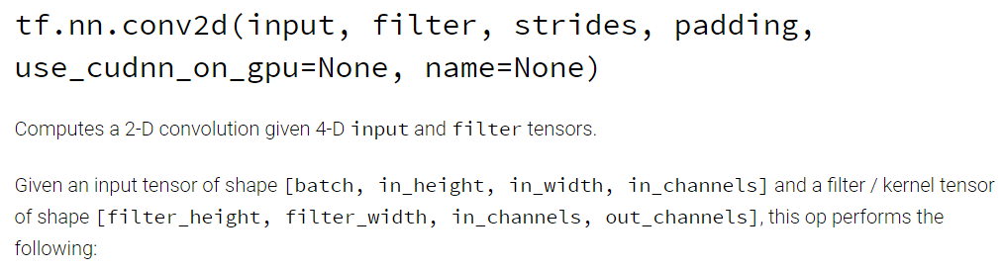
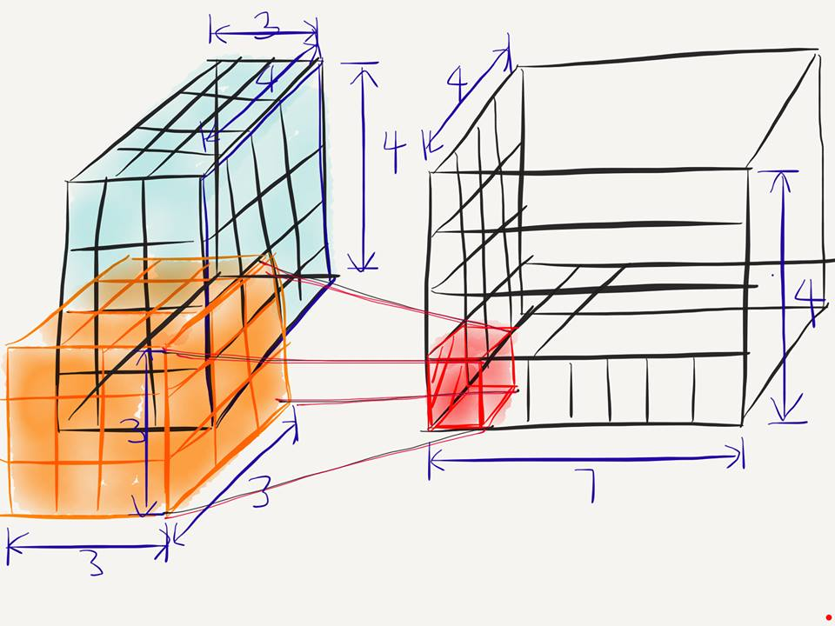
Conv2D
[batch, in_height, in_width, in_chnnel]
[filter_height, filter_width, in_channels, out_channels]
[batch, in_height=4, in_width=4, in_chnnel=3]
[filter_height=3, filter_width=3, in_channels=3, out_channels=7]

Slide 37
Conv2D
[batch, in_height=4, in_width=4, in_chnnel=3]
[filter_height=3, filter_width=3, in_channels=3, out_channels=7]
What is the number of parameters in this convolution layer?
→ $189= 3∗3∗3∗7$

Slide 38
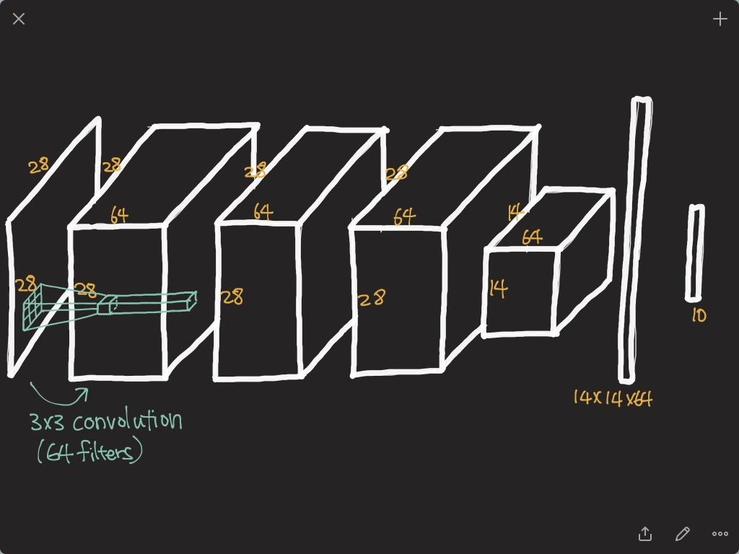

Slide 39
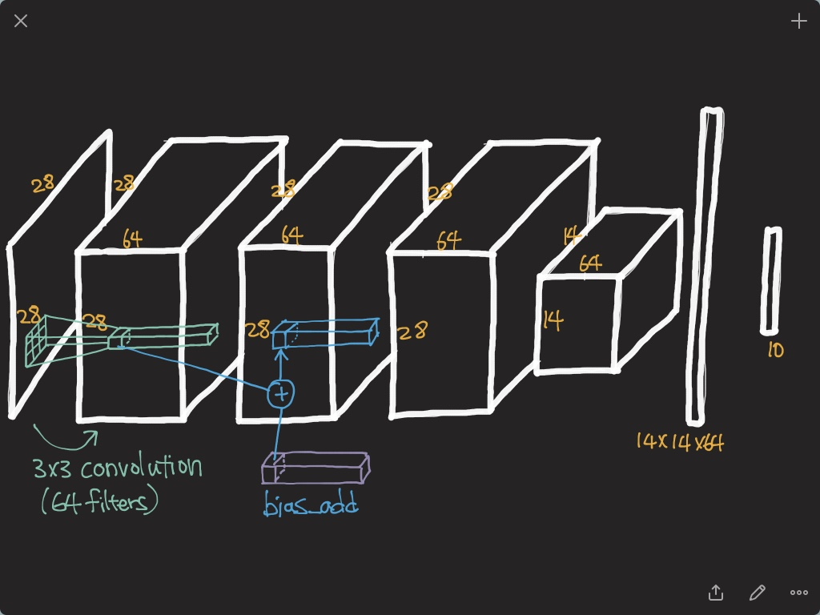

Slide 40
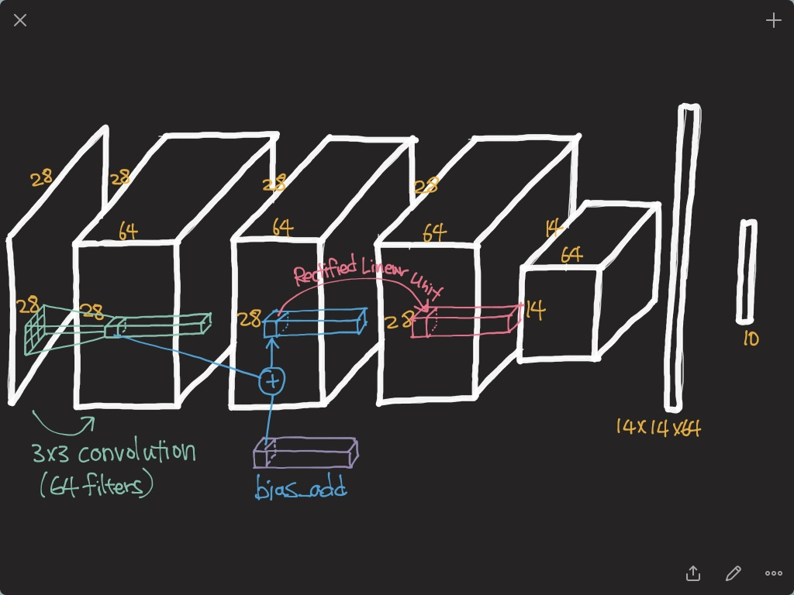

Slide 41
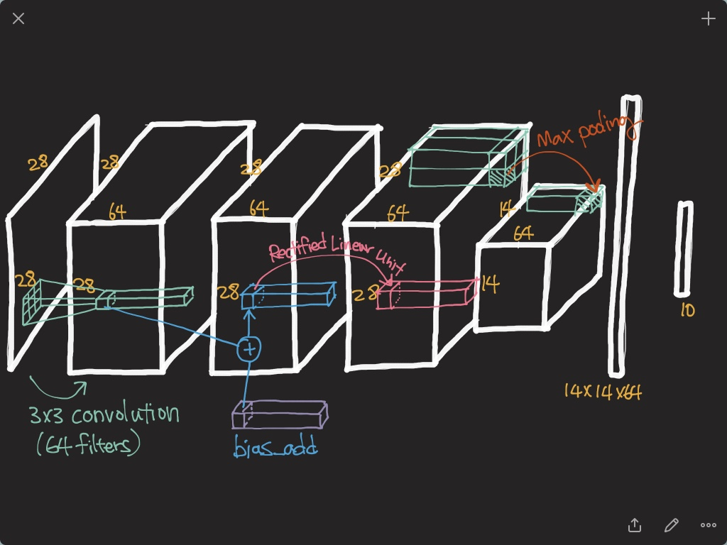

Slide 42
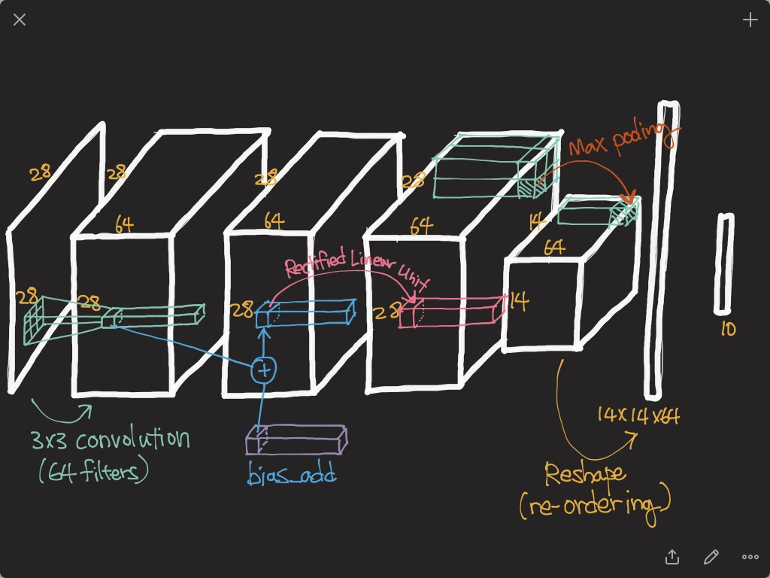

Slide 43
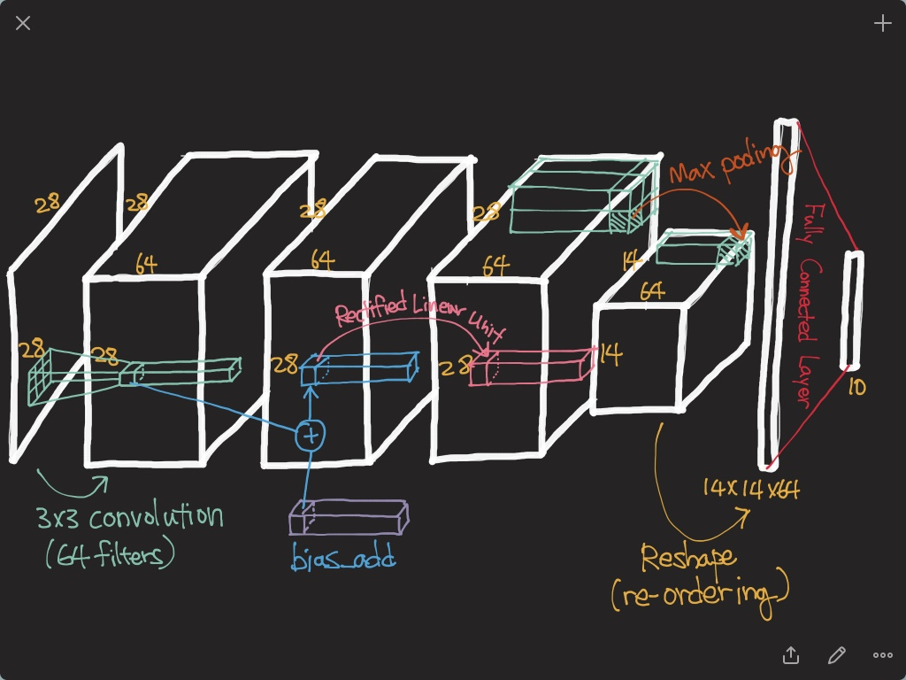

Slide 44
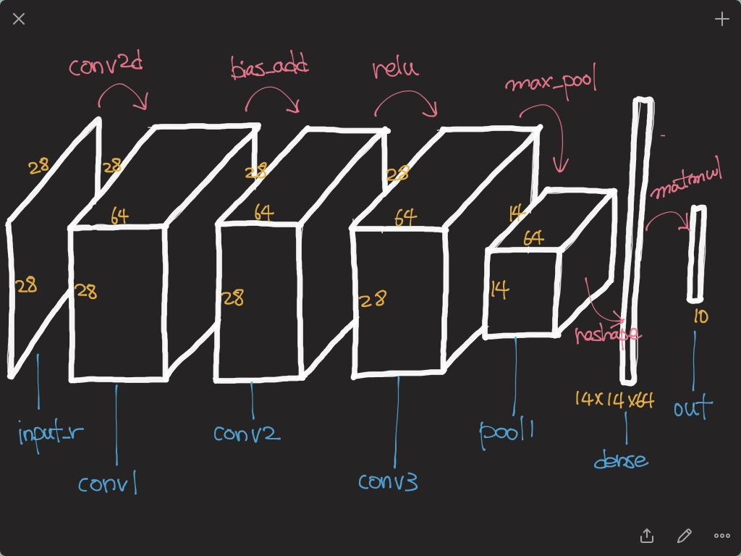

Slide 45
